Slide 1
caTissue v2.0 - caCORE Tools
Jamboree - 2011
June 2011

Slide 2
Outline
caTissue v2.0 Architecture
SDK
CSM
CGMM
CLM
Upcoming

Slide 3
caTissue v2.0 - Technology stack
caCORE 4.2
CSM 4.2
caGrid 1.4
JDK 1.6
Oracle 11g
MySQL 5.x

Slide 4
caTissue v2.0
Process improvement: code auto generation based on UML model
Arbitrary integration with local clinical databases using read/write APIs
Provide grid support for writable APIs
Integrated API across static and DE model
Distributed authorization entities for instance-level security
Logging and auditing (log levels, using this data for operations analysis)
Upgrade from caCORE SDK v3.2 to SDK 4.2
Upgrade from CSM 3.2 to CSM 4.2

Slide 5
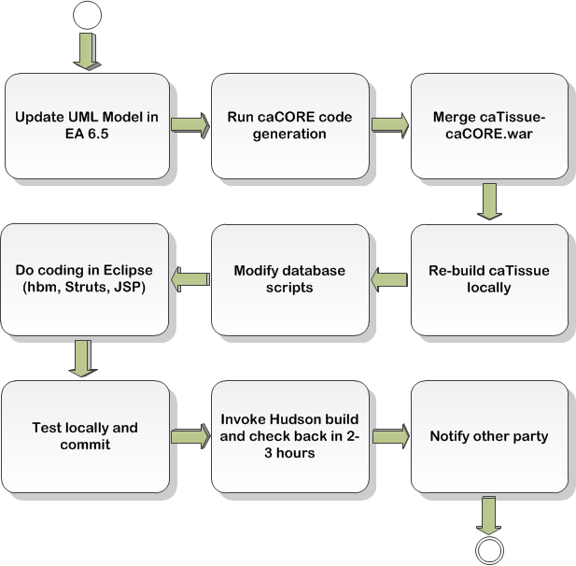
caTissue – SDK Code generation
One day in the life of caTissue developer

Slide 6
caTissue – SDK (Code generation + Runtime)
Auto-generate artifacts using caCORE v4.2 which are referred for all search operations.
Ability to expose the entire search APIs provided by caCORE v4.2 in caTissue.
Ability to create, and update data using caCORE v4.2
caCORE authentication and authorization via CSM, validation and common logging features will be integrated with caTissue v2.0. (Note: Might not be completed in the scope of v2.0.)
Use of caTissue delegator to perform bizlogic in addition to caCORE API capabilities (Query, Wirte).
Non caCORE APIs will be exposed as extra APIs for executing special searches without customize the caCORE internal code.

Slide 7
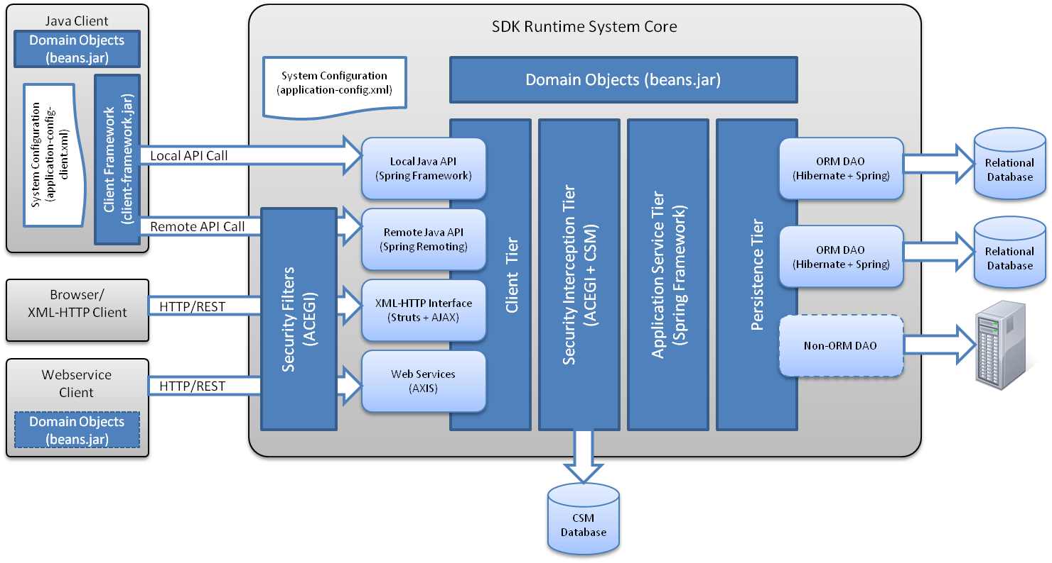
SDK Architecture

Slide 8
SDK - caTissue Implementation
caCORE SDK Client
caTissue UI
caTissue 2.0
caCORE SDK 4.2 Service
caTisseCOREDAOImpl
CaCoreAppServicesDelegator
SDK ORMDAOImpl
caTissueBizLogic
DAO
caTissue DB
SDK 4.2

Slide 9
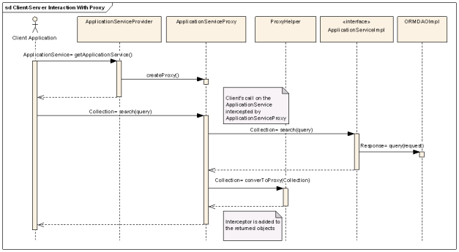
SDK – Default Implementation

Slide 10
caTissue Implementation -CaCoreAppServicesDelegator
public Object updateObject(String userName, Object domainObject) throws Exception {
DAO dao = null;
try {
this.checkNullObject(domainObject, "Domain Object");
final String objectName = domainObject.getClass().getName();
final IBizLogic bizLogic = this.getBizLogic(objectName);
final AbstractDomainObject abstractDomainObject = (AbstractDomainObject) domainObject;
this.checkNullObject(abstractDomainObject.getId(), "Identifier");
final Object object = bizLogic.retrieve(objectName, abstractDomainObject.getId());
if (object == null) {
throw new Exception("No such domain object found for update !! "
+ "Please enter valid domain object for edit");
}
AbstractDomainObject abstractDomainOld = (AbstractDomainObject) object;
dao = AppUtility.openDAOSession(null);
abstractDomainOld = (AbstractDomainObject) dao.retrieveById(Class.forName(objectName).getName(), Long.valueOf(abstractDomainObject.getId()));
bizLogic.update(abstractDomainObject, abstractDomainOld, 0, this
.getSessionDataBean(userName));
logger.info(" Domain Object has been successfully updated "
+ domainObject);
} catch (final Exception e) {
logger.error("Delegate Edit" + e.getMessage(), e);
throw e;
} finally {
AppUtility.closeDAOSession(dao);
}
return domainObject;
}
Repeated retrieval

Slide 11
caTissue Implementation - CaCoreAppServicesDelegator
public List<Object> searchFilter(String userName, List<?> list)
throws Exception {
int maxRecordsPerQuery = Integer.parseInt(XMLPropertyHandler
.getValue(Constants.MAX_RECORDS_PER_CACORE_QUERY_ALLOWED));
if (list.size() > maxRecordsPerQuery) {
throw new Exception(
"The result size is greater than allowed maximum recors per query.");
}
boolean isUserisAdmin = checkIfUserIsAdmin(userName);
List<Object> filteredObjectList = filterDisabledObjects(list, userName,
isUserisAdmin);
return filteredObjectList;
}
SDK query handles result count per query through configuration setting

Slide 12
caTissue Implementation - CaCoreAppServicesDelegator
private List<Object> filterDisabledObjects(List<?> list, String userName, boolean isUserisAdmin) throws Exception
{
if (object instanceof AbstractDomainObject) {
AbstractDomainObject abstractDomainObject = (AbstractDomainObject) object;
try {
final Method activityStatusMethod = abstractDomainObject
.getClass().getMethod("getActivityStatus", null);
final String activityStatus = (String) activityStatusMethod.invoke(abstractDomainObject, null);
if (!Constants.DISABLED.equalsIgnoreCase(activityStatus)) {
result.add(abstractDomainObject);
}
} catch (final Exception ex) {
logger.error("In CaCoreAppServicesDelegator”+ ex.getMessage());
result.add(abstractDomainObject);
}
} else if (!isUserisAdmin) {
throw new Exception("caTissue doesnot support queries which returns result list containing instances of classes other than "
+ "caTissue domain model");
} else {
// Add object to list as it is nit caTissue domain objectFor
// e.g Admin user queries on get id from domain object
result.add(object);
}
Add search criteria based on user role to filter objects with inactive status

Slide 13
caTissue – Security
caTissue v2.0 can be deployed in one of two modes – local authentication or caGrid authentication mode.
A caTissue instance can be configured to either use a local CSM or any local Identity Providers (IdPs). Thus in Local mode, CSM or one or more institution IdPs will be used for authentication and authorization is performed by caTissue’s CSM.
In caGrid mode, NCI dorian or any other configured Dorian/s is used as the Identity Federation Service (IFS) that determines the list of valid IdPs.
Authentication
Able to sign up in caTissue using a particular IdP registered to a caGrid Dorian for authentication
Able to migrate an existing user to a caGrid Dorian-approved IdP for authentication
Allow administrators (superadmin or site admin) to provision a user by selecting any of the caGrid IdPs the user belongs to and to set that IdP for authentication for that user
Authorization
Able to propagate collection protocol privileges to caGrid users and groups

Slide 14
caTissue Implementation – CSM Role
// Used for Authentication, Authorization through CSM
/** The Constant ADMIN_USER. */
public static final String ADMIN_USER = "1";
/** The Constant NON_ADMIN_USER. */
public static final String NON_ADMIN_USER = "7";
/** The Constant SUPER_ADMIN_USER. */
public static final String SUPER_ADMIN_USER = "13";
private boolean checkIfUserIsAdmin(String userName) throws Exception {
boolean isUserisAdmin = false;
logger.debug("User Name : " + userName);
final User validUser = AppUtility.getUser(userName);
final ISecurityManager securityManager = SecurityManagerFactory
.getSecurityManager();
try {
securityManager.getUserRole(validUser.getCsmUserId());
if (Constants.ADMIN_USER.equalsIgnoreCase(UserUtility
.getRoleId(validUser))) {
isUserisAdmin = true;
}
} catch (final SMException ex) {
logger.error("Review Role not found!" + ex.getMessage(), ex);
ex.printStackTrace();
}
return isUserisAdmin;
}
Hard coded role identifiers. CSM API can be used to check role.

Slide 15
caTissue Implementation - CaCoreAppServicesDelegator
private List<Object> filterObjects(String userName, List<Object> objectList)
throws Exception {
// indicates whether user has READ_DENIED privilege on the object.
boolean isReadDenied = false;
// indicates whether user has privilege on identified data.
boolean hasPHIAccess = false;
.
.
.
Instance and attribute level security can be used for better performance.

Slide 16
caTissue Query security
Instance and attribute level security can be used.

Slide 17
caTissue Authorization – Groups, Roles
At the time of application deployment, the system provides default roles and privileges. These privileges can be edited using the application by a user having appropriate privileges
Once a user is created via caTissue Suite, a User object is created and inserted into the csm_user table. The user is then assigned to the appropriate user group by the application. The user is associated with the Administrator, Supervisor, Technician, or Public(Scientist) group based on the role that user is assigned.
Runtime provisioning using CSM APIs
Ships with Default Privileges and Roles
Each role in caTissue is a User Group in CSM

Slide 18
caTissue - UPT
UPT is a user provisioning tool for Administrators
UPT tight UI implementation can’t be included or extended into caTissue application
caTissue implemented user provisioning as part of its application
User creation (through UI)
Security provisioning (Runtime assignment)
Use of UPT is not recommended by caTissue
Predefined roles, groups, protection elements
Application logic has hardcoded way of checking provisioned security
UPT doesn’t support enabling, disabling or making read only of security provisioning features

Slide 19
caTissue Implementation - CatissueDefaultBizLogic
Inconsistent use of CSM APIs to check permissions
Hand coded protection element, privilege, role, group names
public boolean isAuthorized(DAO dao, Object domainObject, SessionDataBean sessionDataBean,Object uiObject)
throws BizLogicException
{
boolean isAuthorized = false;

Slide 20
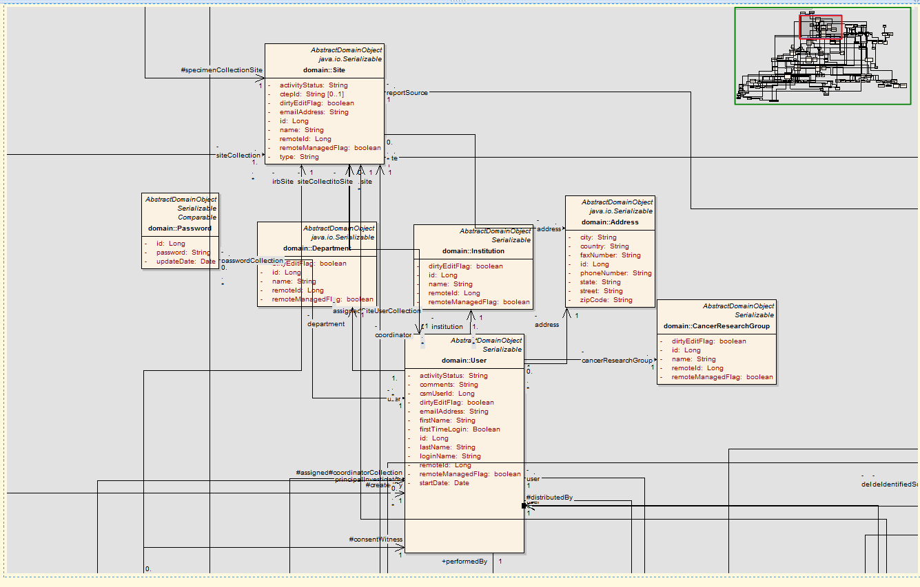
caTissue Model - User

Slide 21
caTissue Security – CSM User
caTissue security is duplicating Password exists in CSM
caTissue security is duplicating user attributes exists in CSM
CSM_USER
DEPARTMENT
EMAIL_ID
END_DATE
FIRST_NAME
LAST_NAME
LOGIN_NAME
MIGRATED_FLAG
ORGANIZATION
PASSWORD
PHONE_NUMBER
PREMGRT_LOGIN_NAME
START_DATE
TITLE
UPDATE_DATE
USER_ID
CSM Schema can co-locate with caTissue Schema (Requirement for Instance Level Security)

Slide 22
caTissue Login Migration - CGMM
caTissue requirement is “Existing users should be able to migrate their local CSM account to their corresponding caGrid user account for authentication. The user will then be authenticated using caGrid approved IdP (i.e. registered at a caGrid Dorian) and authorized based on caGrid user using caTissue’s local CSM. Currently caTissue supports this for local IdPs.”
CGMM (CSM GAARDS Migration Module) can be used to achieve above requirement
Provides a two-tiered solution for existing web applications, namely to:
1. Migrate existing CSM accounts to caGrid accounts,
2. Act as the authentication „module‟ for the host application.
https://gforge.nci.nih.gov/docman/view.php/12/18946/CSM_GAARDSMigrationModuleGuide_v0.6.pdf

Slide 23
CGMM
The CGMM provides the following solutions for the host application:
Authentication – CGMM validates and verifies a user‟s CSM (local) credentials to initiate migration, and validates and verifies a user‟s caGrid Login ID and password against an Authentication Service. Once an already migrated user is authenticated, the CGMM passes the control to the host application by providing the user‟s information and Grid Proxy.
Migration – CGMM migrates or transforms a CSM user to a caGrid user. The migration involves updating the CSM account (Login ID) information with the caGrid account (Login ID) in the CSM schema of the host application.
New caGrid User Creation – CGMM creates a new caGrid (Dorian) account for a new or existing User. Once the user has a caGrid account, the CGMM can migrate the user for the host application.
Configurable CGMM Tool – CGMM allows for the enabling or disabling of the New caGrid User creation feature of the CGMM Tool. CGMM also allows for the configuration of other information, such as host application information and Authentication Service and Dorian Service information.
CGMM API – The CGMM API allows programmatic access and integration of the CGMM features.

Slide 24
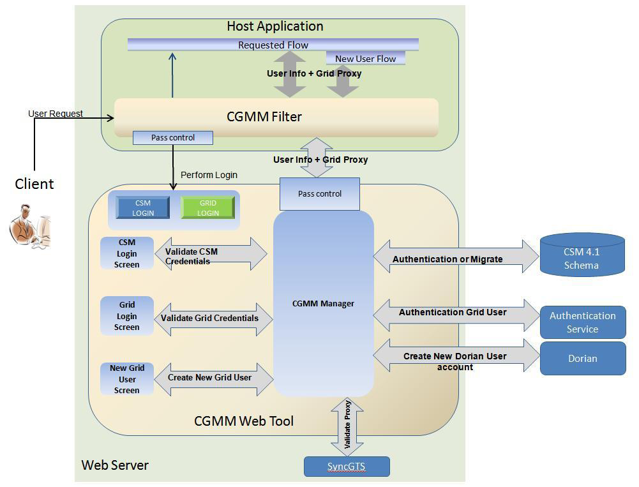
CGMM
Notes:
As shown, CGMM is a web application that is hosted on the same application server as the Host web application. The Host application uses a migration filter, CGMMMigrationFilter, provided by the CGMM to forward all un-authenticated user requests. The GAARDS components used are Authentication Service, Dorian Service, and SyncGTS.

Slide 25
caTissue Distributed Authorization - GridGrouper
Grid Grouper Integration is a part of a major development effort to enable federation of caTissue user authentication and authorization across multiple institutions. At this point, caTissue Grid Authentication component has already been implemented and covers both grid user authentication and local-to-grid user migration tasks.
The main goal of Grid Grouper Integration is to allow centralized management of a caTissue user’s group membership information that can span more than a single institution or organization. Thus, for example, different authorization policies can be applied to a single user at different institutions running caTissue and without requiring separate provisioning steps at each individual institution.

Slide 26
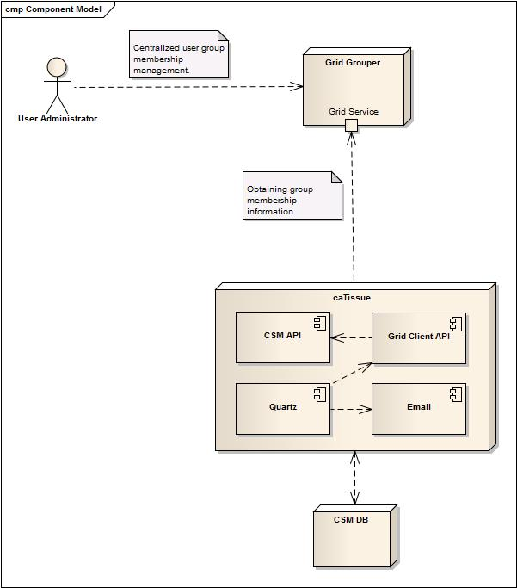
caTissue - GridGrouper

Slide 27
CSM Service – caGrid community Project
caTissue may consider using CSM Service project to use Grid grouper groups along with CSM synchonization.
The CSM service's other responsibility is related to the administrative function of creating a user group definition in the CSM authorization model that is linked to a group defined by a gridGrouper Server. The CSM service is responsible for getting the definition for a linked group from the gridGrouper server. It is also responsible for keeping the definition of a linked user group in the CSM authorization model consistent with its definition in the gridGrouper server.

Slide 28
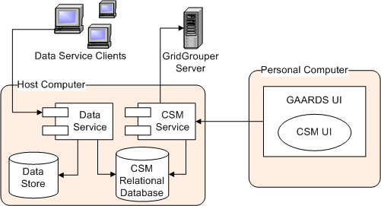
CSM Service – caGrid community Project

Slide 29
caTissue Auditing - CLM
caTissue may consider using CLM to support auditing
CLM is a set of tools that provides a flexible and comprehensive solution for auditing and logging. CLM has the following components:
Event Logging - This feature provides a log4j-based solution allowing users to log events. Since this feature provides the ability to propagate and store user information, it can be used for anything from auditing a user to detecting security breaches.
Automated Object State Logging - This tool provides an automated, Hibernate-based, object state logging mechanism to log the changes to an object's state.
Asynchronous Logging to database - This feature provides a log4j based JDBC appender that can log the messages to the database asynchronously. Asynchronous logging increases performance for applications that generate a high volume of log messages.
Query Interface - A new Query API provides programmatic access to the logged data. It also can return the log result in form of an XML document.
Web-based Log Locator Tool (LLT)- This tool is a web-based application that displays, searches, and filters log messages. The interface can be used to retrieve logs based on elements including timestamp, user ID, and log level. The LLT can now use CSM for User Provisioning as well as security.

Slide 30
Considerations
SDK Improved releases
CSM – UPT improvements
NCI CBIIT Technology stack compliance

Slide 31
SDK 4.3
Provide support for ISO 21090 Datatypes as class attributes
Provide support for Java Architecture for XML Binding (JAXB) marshalling and unmarshalling of both ISO 21090 data types and non-ISO data types
Provide support for selectively generating (enabling) the following interfaces:
-- Local Java Interface
-- Remote Java Interface
-- Web Service Interface
-- RESTful XML Interface
-- RESTful HTML Interface
-- RESTful JSON Interface
Provide support for CSM class-level security
Provide support for Blobs/Clobs in MySQL, Oracle and Postgres DB's
Provide support for selectively disabling pagination
Bug Fixes (Gforge # 19979, 20474, 24626, 27044, 27045, 27216)

Slide 32
SDK 4.4
Integration with ISO 21090 Data Type 2.1.1 Common Library. SDK 4.4 integrates the ISO 21090 Data Type v2.1.1 Common Library jars.
Support for ISO 21090 Data Types within the SDK Internal Query Engine. The SDK internal query engine has been enhanced in SDK 4.4
to support ISO data type queries.
Support for ISO 21090 Data Types within the Web User Interface. The web interface is disabled in SDK 4.3 whenever support for ISO
data types is enabled
Support for ISO 21090 Data Types within the RESTful JSON and HTML Interfaces. The RESTful interfaces are disabled in SDK 4.3
whenever support for ISO data types is enabled.
Bug Fixes (Gforge # 28837, 28840, 27529)

Slide 33
SDK 4.5
Tech stack upgrade (2010 current & future)
Feature requests:
Support modeling with non-marker interfaces and operations
Support modeling with custom getter/setter operations
Support implementing interfaces in Logical model
Support 3party jars as part of code generation
Support bi-directional self associations
Automated Junit test generation
Non-nullable attributes in generated Hibernate mapping files

Slide 34
CSM-UPT-CGMM / CLM-LLT
UPT Enhancement plan is underway (Community requested)
Bug fixes
Enhancements
Upgrading to 2010 technology stack (Current, Future)

Slide 35
Contact Us
Knowledge Center Forum
https://cabig-kc.nci.nih.gov/CaGrid/forums/viewforum.php?f=26&start=0
SDK Users Mailing List
cacore_sdk_users-L@list.nih.gov

